Slide 2
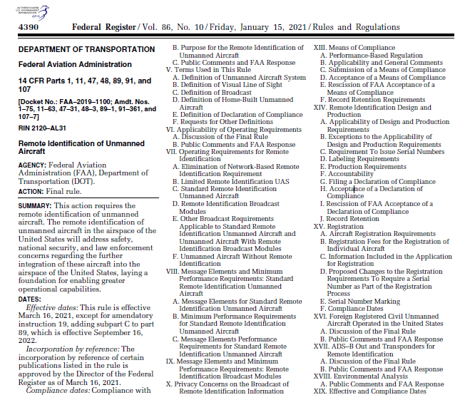
Final Rule: Remote Identification of Unmanned Aircraft
Manufacturer Compliance Date: September 16, 2022
Operational Compliance Date: September 16, 2023
Discretionary Enforcement Period Regarding Operational Compliance: September 16, 2023 - March 16, 2024
Notes:
On January 15, 2021, the FAA’s final rule on Remote Identification of Unmanned Aircraft or Remote ID was published in the Federal Register.
The rule became effective on April 21, 2021, and it established two very important dates:
September 16, 2022 was the compliance date for manufacturers. All drones produced for sale in the U.S. must meet the standard Remote ID equipment requirements.
September 16, 2023 was the operational compliance deadline. All drone pilots who are required to register their drones must operate in accordance with the Remote ID rule.
On September 15, 2023, the FAA published a notice of enforcement policy in the Federal Register advising they will exercise their discretion in determining how to handle any apparent operational noncompliance with Remote ID, including exercising discretion to not take enforcement action, if appropriate. More information is available here:
https://www.federalregister.gov/documents/2023/09/15/2023-20074/enforcement-policy-regarding-operator-compliance-deadline-for-remote-identification-of-unmanned
https://www.thedronegirl.com/2023/09/21/remote-id-enforcement/
The final rule applies to recreational flyers, part 107 pilots, and public safety organizations using drones.

Slide 3
What is Remote ID?
Notes:
We often refer to Remote ID as a “digital license plate” for your drone.
But, this short video explains it better than I can.
[https://www.youtube.com/watch?v=DPygWZ3jyAo]

Slide 4
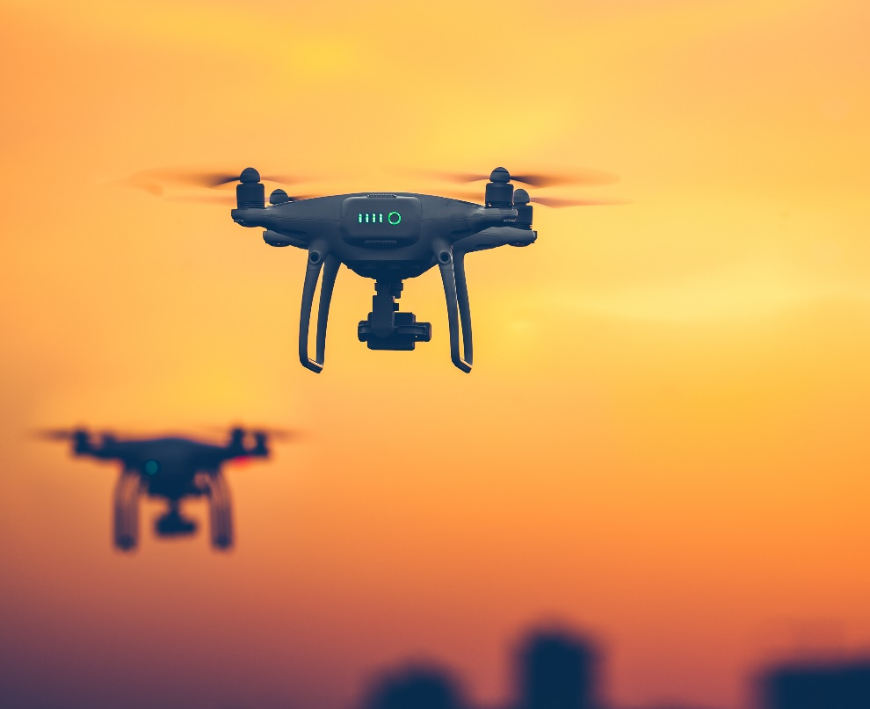
Why Is Remote ID Needed?
Remote ID is necessary to ensure the safety and security of the U.S. airspace and the public
Remote ID provides awareness of a drone’s location in flight
The information can be used to distinguish compliant airspace users from those potentially posing a safety or security threat
Remote ID builds on existing foundations for more complex drone operations
Notes:
As you saw in the video, two key objectives for Remote ID are safety and security:
Remote ID provides information about drones in flight, such as the drone’s identity, location, altitude, and control station or take-off location
This awareness helps the FAA, national security agencies, local law enforcement agencies, and other government officials distinguish compliant airspace users from potential threats
But Remote ID is also a necessary building block for more complex operations like routine package delivery, operations over people, and beyond visual line of sight

Slide 5
How Can I Comply?
Notes:
There are three ways drone pilots can meet the identification requirements of the Remote ID rule:
Operate a Standard Remote ID drone. This is a drone that broadcasts identification and location information of the drone and control station. A Standard Remote ID drone is one that is produced with built-in Remote ID broadcast capabilities in accordance with the Remote ID rule's requirements.
Operate a drone with a Remote ID broadcast module. A broadcast module is a device that broadcasts identification and location information about the drone and its take-off location in accordance with the Remote ID rule's requirements. The broadcast module can be added to a drone to retrofit it with Remote ID capabilities. Pilots operating a drone with a Remote ID broadcast module must be able to see their drone at all times during flight.
Operate (without Remote ID equipment) (PDF) at FAA-recognized identification areas (FRIAs) sponsored by community-based organizations (CBOs) or educational institutions. FRIAs are the only locations where UAS (drones and radio-controlled airplanes) may operate without broadcasting Remote ID message elements.

Slide 6
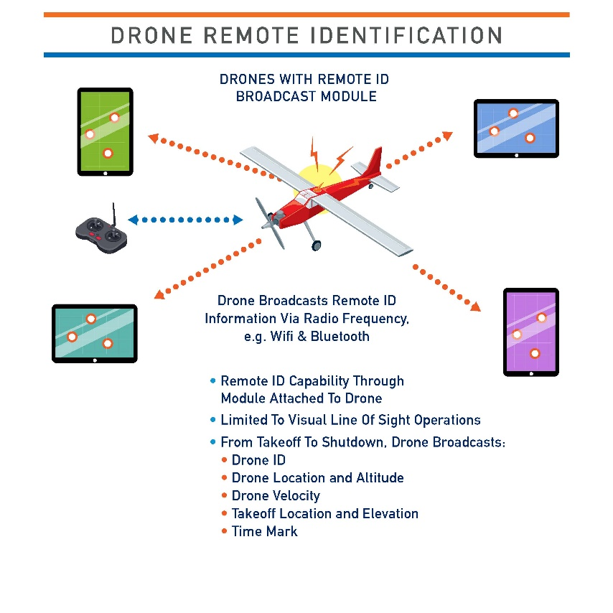
What Am I Broadcasting?
Notes:
The minimum message elements contained in a broadcast message from Standard Remote ID drone include:
A unique identifier – this is usually the Remote-ID compliant serial number
The location, altitude, and velocity of the drone
The location and altitude of the drone’s control station
A time mark
The emergency status of the drone
The minimum message elements contained in a broadcast message from a drone with a Remote ID broadcast module include:
The unique identifier – the Remote ID compliant serial number
The location, altitude, and velocity of the drone
The location and altitude of the drone’s launch point
A time mark
We know that a lot of people have privacy concerns about broadcasting their location…..

Slide 7
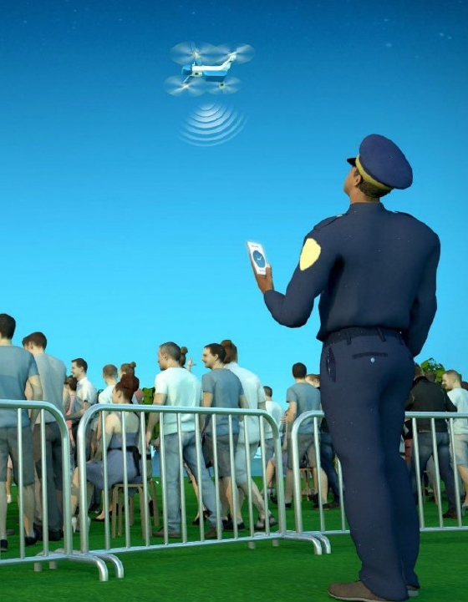
Is My Personal Information Involved?
While anyone can receive broadcast Remote ID data, only authorities with the appropriate permissions may be able to correlate that data to FAA-held data including registration data, which has Personal Identifiable Information, or PII.
The unique identifier (Remote ID-compliant serial number) from the broadcast remote ID message is necessary for executing data correlation functions
Notes:
Numerous third-party software applications are available for displaying the Remote ID broadcast information as the radio frequency signals (Wi-Fi or Bluetooth) are readily detected by everyday mobile phones.
However, these applications do not provide personally identifiable information provided to the FAA through the FAADroneZone.
Only the FAA, security partners, and local law enforcement will have the ability to correlate that information to the aircraft owner

Slide 8
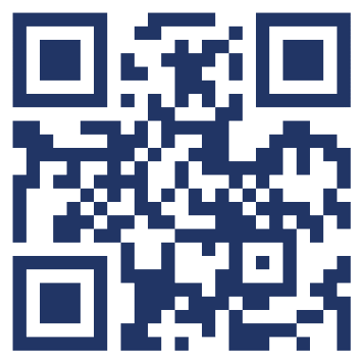
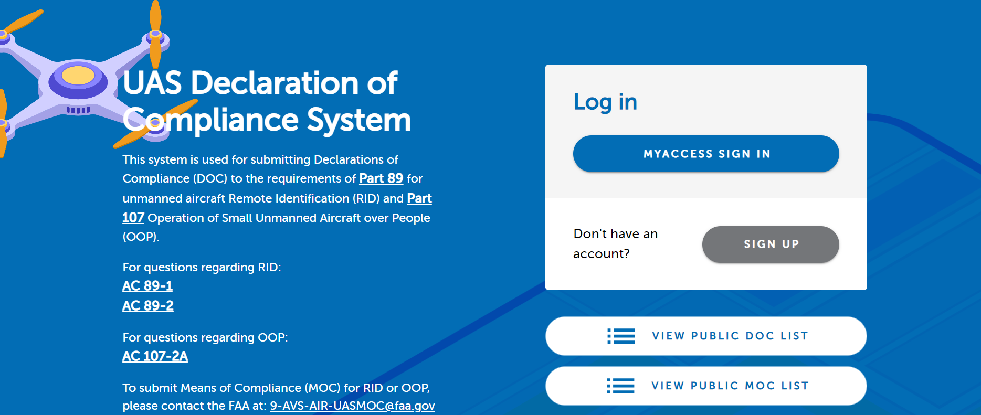
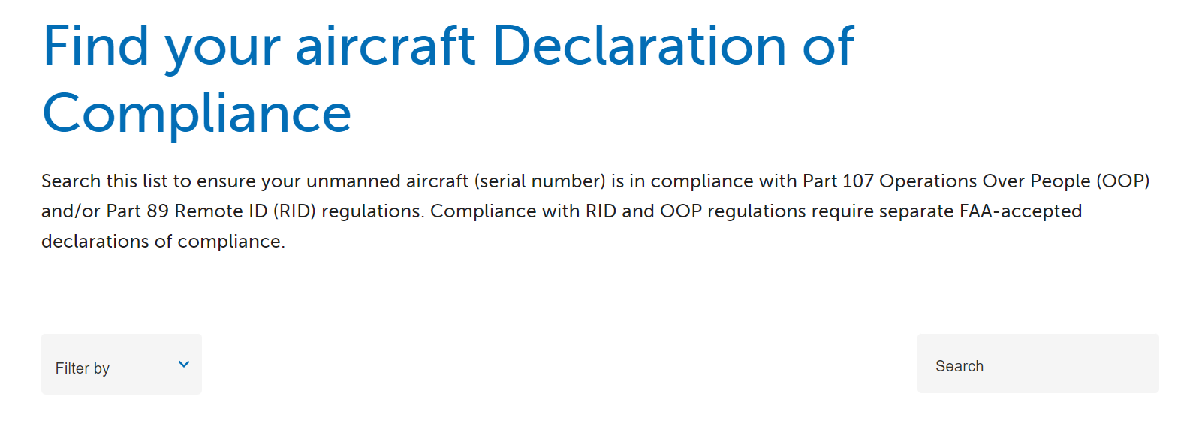
Is My Drone or Broadcast Module Remote ID Compliant?
Step 1: https://uasdoc.faa.gov/login
Step 2: Click on “View Public DOC List”
Step 3: Search
UAS DOC website
Notes:
You can find out if your drone has standard remote ID by searching the FAA’s Declaration of Compliance website.
At this website, click on “View Public DOC List.”
You can search by model or serial number.
If your drone or broadcast module is not listed, you may still fly in a FRIA.

Slide 9
Updating Registration – Recreational Flyers
Step 1: Log in to FAADroneZone
Click on the button labeled “Launch Drone Owners and Pilots Dashboard”
Be sure you are on the Recreational Flyer Dashboard
Step 2: Click on “Manage Device Inventory”
Click on “Add Device”
Answer the Remote ID question “Yes”
Choose the device type from the drop down menu (Remote ID broadcast module or Standard Remote ID drone)
Enter the Remote ID serial number (NOTE: this number may be on either the device or the controller)
Click on “Add Device”
Step 3: Return to “Your Inventory”
To cancel a previously registered device, click on three vertical dots associated with device under the “Actions” column and select “Cancel”
Notes:
If your drone or broadcast module is listed on the Public DOC List, you need to register or update your existing drone registration through FAADroneZone to include the Standard Remote ID drone or Remote ID broadcast module serial number.
Recreational pilots may register once and apply that unique registration number to multiple aircraft.
This allows a recreational pilot to move a Remote ID broadcast module from drone to drone as long as it is listed on the same registration.
If using one broadcast module on multiple non-Standard Remote ID drones, select broadcast module for each and input the particular drone(s) make/model while using the same Remote ID serial number from the module.
If you’d like to cancel the previously registered non-Standard Remote ID drone, while in your inventory, click on the three vertical dots associated with the drone under the “Actions” column and select “Cancel” from the drop down menu
A canceled device will remain in your inventory as “cancelled”

Slide 10
Updating Registration – Part 107 Pilots
Step 1: Log in to FAADroneZone
Click on the button labeled “Launch Drone Owners and Pilots Dashboard”
Be sure you are on the Part 107 Dashboard
Step 2: Click on “Manage Device Inventory”
Click on the three vertical dots associated with the drone in the “Actions” column and select “Edit” from the drop down menu
Edit the answer to the Remote ID question to “Yes”
Enter the Remote ID serial number from either the updated Standard Remote ID drone or the Remote ID broadcast module: (NOTE: this number may be listed on either the device or the controller)
Click on “Save”
Step 3: Return to “Your Inventory”
Notes:
Part 107 pilots need to register each Standard Remote ID drone or Remote ID broadcast module separately, which means each one will get a unique registration number.
Both recreational flyers and Part 107 pilots have until the end of this calendar year to update their registration for free.

Slide 11
Notice of Identification – Foreign Registered Drones
Notice of Identification (NOI) is a service provided by the FAA for operators to notify their intent to fly a foreign registered drone in the NAS.
Step 1: Log in to FAADroneZone
Click on “Add a Service”, “Select Notice Service”, “Add Service”, and “Launch Notice Dashboard”
Review your NOI application profile then click on “Confirm Profile”
Step 2: Click on “Create a Notice”
Fill out the NOI form and then click on “Save & Proceed”
Step 3: Click on “Add Aircraft”
Fill out the form and then click on “Add Aircraft”, “Save & Proceed”, and “Submit”
You will receive a Confirmation of Identification (CID)
Notes:
Foreign visitors traveling to the U.S. with a drone registered in another country need to provide notice of identification before flying in the U.S.
U.S. citizens flying a drone registered in another country must also provide notice of identification.

Slide 12
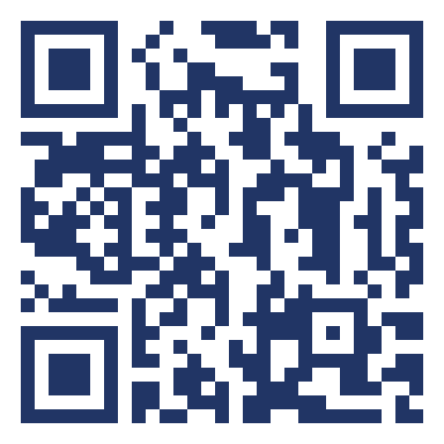
FRIAs
Can be requested by FAA-recognized CBOs and educational institutions
Both the drone and the pilot of the drone must remain in the boundaries of the FRIA throughout the operation
The pilot of the drone must be able to see it at all times throughout the duration of the flight
Remote ID compliant drones may operate in a FRIA, but must continue to broadcast Remote ID
UDDS website
https://udds-faa.opendata.arcgis.com/
Notes:
An FAA recognized identification area or FRIA is a defined geographic area where drones can be flown without Remote ID.
FAA-recognized Community Based Organizations and educational institutions can request FRIAs through the FAADroneZone.
When flying in a FRIA, both the pilot and the drone must remain in the boundaries of the FRIA throughout the operation.
The pilot must be able to see the drone at all times throughout the duration of the flight.
If the drone is equipped with standard Remote ID or a broadcast module, it may not be disabled or turned off during the flight.
The FAA will be publishing the location of FRIAs on the FAA’s UAS Data Delivery (UDDS) website.

Slide 13
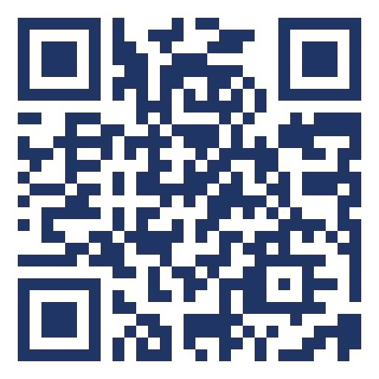
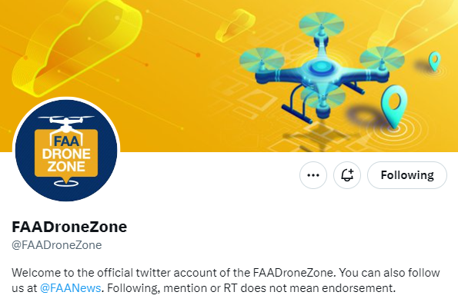
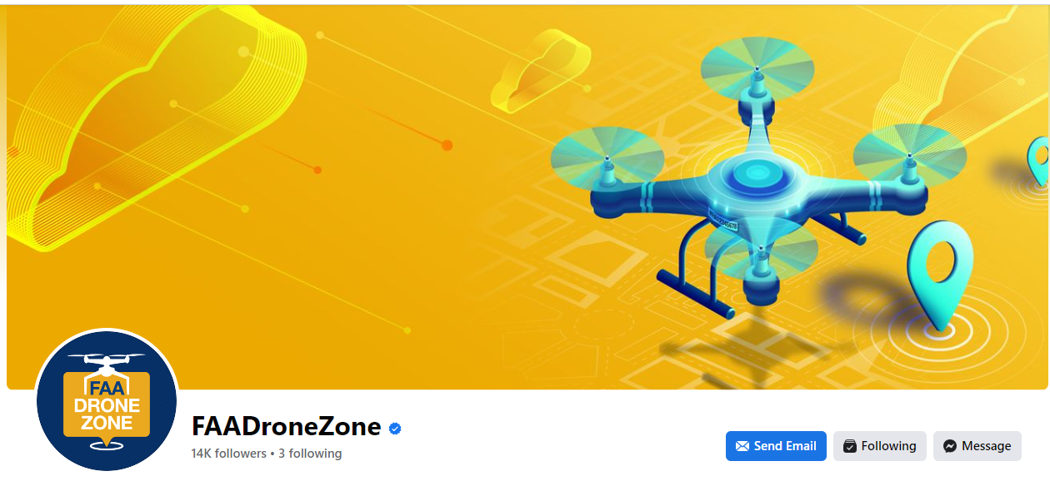
Resources
https://www.faa.gov/uas/getting_started/remote_id
1-844-FLY-MY-UA
UAShelp@faa.gov
Remote ID website
Notes:
We have lots of resources available to help you.
There is a ton of information on our website.
You can also follow the FAADroneZone on Twitter and Facebook.
And you can always contact us by emailing or calling the UAS Support Center.

